Slide 1
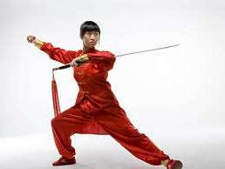
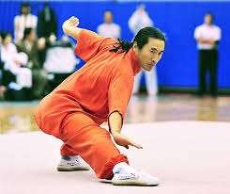
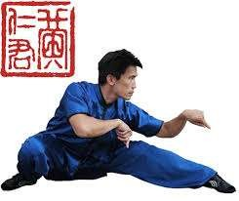
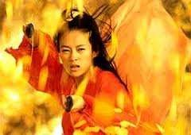

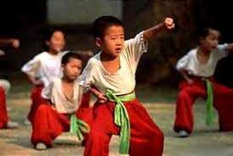
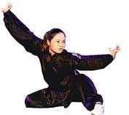
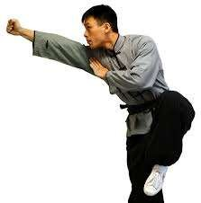
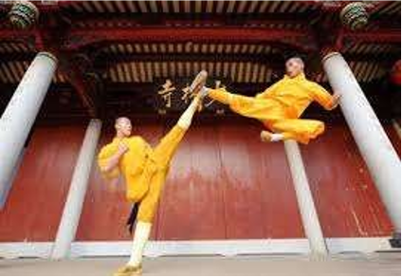
Chinese Martial Art
伊曼沙
M202161014

Slide 2
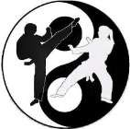
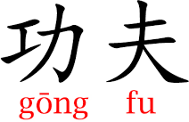
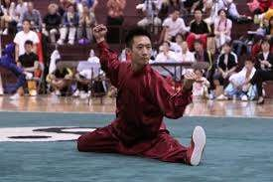
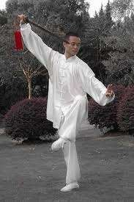
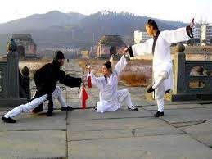
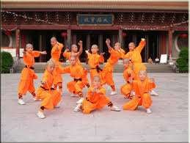
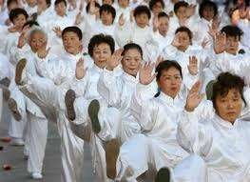


Kung Fu (Gongfu)
es rts
Chinese Kung Fu is a series of figh
ting styl
artial a
Also known as Wushu or Chinese m
Styles: Shaolin, Tai Chi, Qigong
Kung Fu advocates virtue and peace, not aggression or violence
Taiji Quan
Taiji
Shaolin Kung Fu
Wudang Style

Slide 3
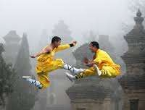
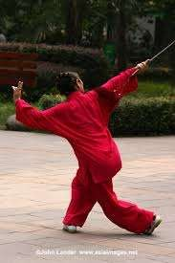
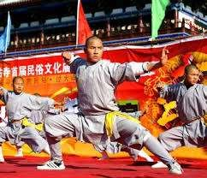
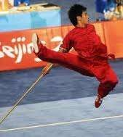
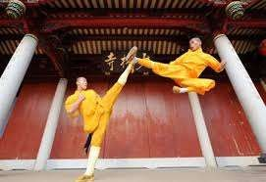
Chinese Kung Fu History
Theory of Kung Fu is based upon classical Chinese philosophy.
Kung Fu has incorporated various combat skills and elements of Chinese philosophies such as Taoism, Buddhism and Confucianism.
Originated from the hunting and defense needs in the primitive society.
In modern times, it develops well and becomes a way for keeping fit, entertainment, and performance.

Slide 4
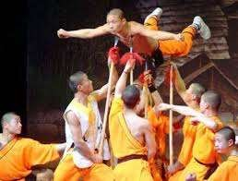
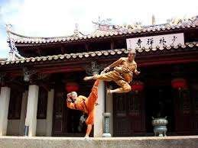
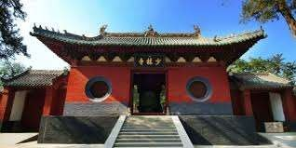
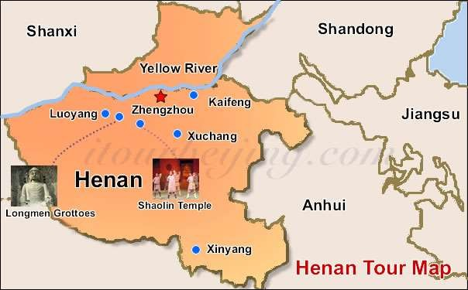
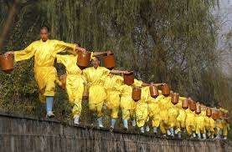
Shaolin Martial Arts
The Chinese martial arts styles that started during the years between 58-76 A.D., with and continue to be tied
olin monks and monastery.
to the Sha

Slide 5
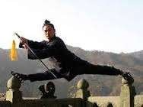
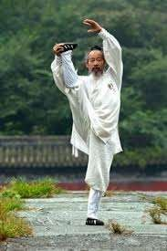
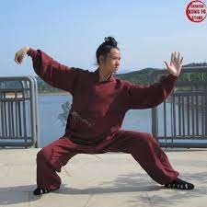
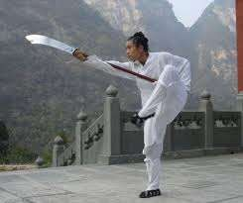
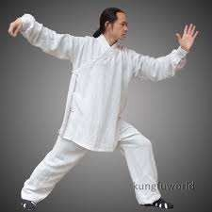


Wu Dang Martial Arts
Wudang Martial Arts were created in the early years of the Ming Dynasty (1368 - 1644) by a Taoist named Zhang Sanfeng.
Originated in Mt. Wudang, a Taoist holy land, it is of great value to fitness and body-building. By now, it has become popular in China and worldwide, as a kind of fitness sport.
Together with the Shaolin School in the north, Wudang School in the south is the most typical representative of traditional Chinese Kung Fu.
t e
a
k
e T
a i
▪At presen Form/Int (Baguazh
, its major s ntion Boxing ng).
ills are w (Xingyiqu
ll presented by
n) and Eight D
ai Chi (Taiji), agram Palm

Slide 6
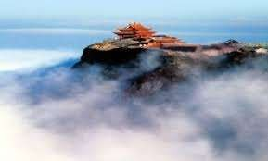
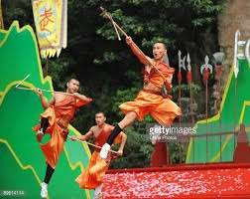
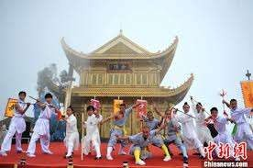
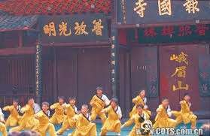
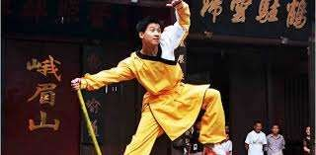
Emei Martial Arts
Emei Martial Arts originated from the pre-Qin period (the 21st
century - 221 BC) in the famous Mt. Emei of Sichuan Province.
It was created by a Kung Fu master named Situ Xuankong, who once imitated the behaviors of the white apes to create the White Ape Sword Skills.
Emei Martial Arts is characterized by the movement of hands or feet, especially the motions of feet changing constantly, quickly and forcefully.

Slide 7



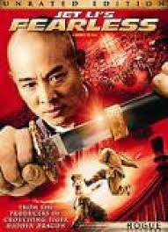
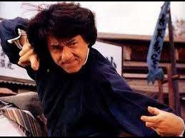
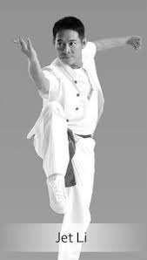
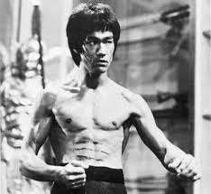
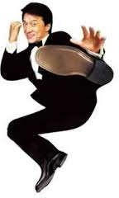
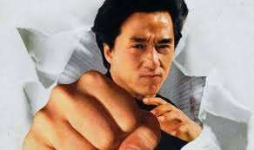
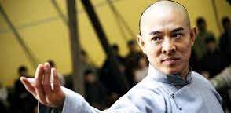
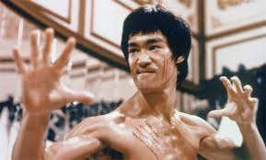
20th century Martial Artists and Actors
Jackie Chan
Jet Li
Bruce Lee

Slide 8
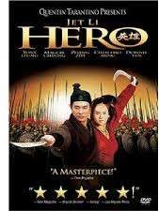
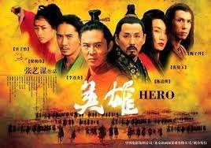
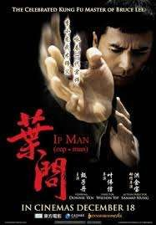
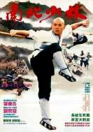
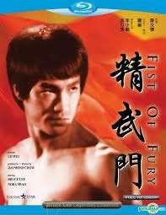
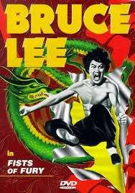
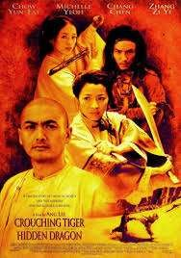




Chinese Kung Fu Movie
Hero
Shaolin Temple
Fists of Fury
Ip Man (Ye Wen)
Drunken Fist
Crouching Tiger, Hidden Dragon
Chinese Zodiac (Armour of God III or CZ 12)

Slide 9







Tai Chi Quan
A Kung Fu style and sports event, Tai Chi (Taijiquan) is a perfect combination of Chinese dialectic ideology, art and martial arts.
It bears a close relation to Chinese ancient Taoism, under the guidance of which a series of practice methods were formed for learning martial arts.
It is characterized by attacking, by accumulating the strength, by conquering the unyielding with the yielding skills and defeating the dynamic with the static.

Slide 10






Chinese Qi Gong
Qigong (Chi Kung) is considered an essence of Chinese Kung Fu.
It is an ancient Chinese health care system that integrates physical exercise, breath control and mental training.
Qi means the life force or energy that exists throughout the universe. Qigong means cultivating energy, which is a beneficial exercise way to strengthen the physical conditions, increase vitality and keep people healthy.

Slide 11








Kung Fu Schools in China
Chinese Kung Fu learning gains popularity mainly because of its emphasis on fitness and self-defense.
Nowadays, many training centers, clubs or schools are open to enrolling enthusiasts. They have to pass tests to weed out the ill suited and retain the committed.
The training includes the basic skills, routines, weapons h
h the practice of int l s
andling and kills are
others, among whic
most important.
ernal and externa

Slide 12
THANK YOU

